Slide 1

K18X001.00 FFC AMP Cable
Analysis Report
Prepared by: PE- Phuong
Date: 2022/05/29

Slide 2
Background Information
Background Information
1. Issue Description
- On 05/05/2022, ALT customer complaint 1pcs FFC cable not working.
- Failure status: Product no sound
Failure information:
Fox_P/N | Cus_P/N | Vendor | ERROR CAUSE
376.00039.005 | 183005-15089 | P-TWO | FFC AMP cable not working

Slide 3

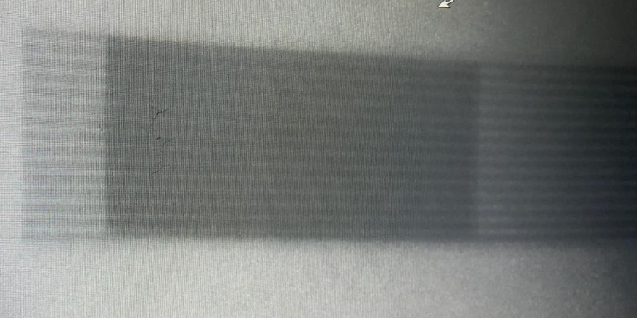
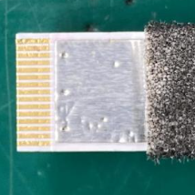

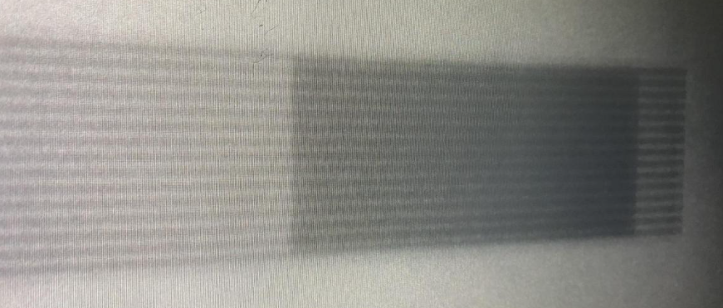
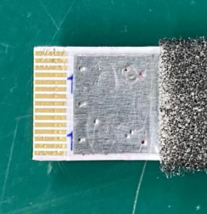
Visual Inspection, X-Ray FFC AMP
Visual inspection
- Visual inspection FFC AMP cable , didn’t see any abnormal
Take X-ray
- X-ray FFC AMP cable didn’t find broken,.. issue
Visual inspection FFC AMP cable
X-ray FFC AMP cable
Summary:
- Visual inspection and X-ray didn’t find out abnormally

Slide 4
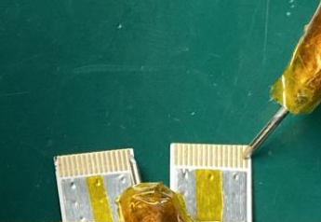
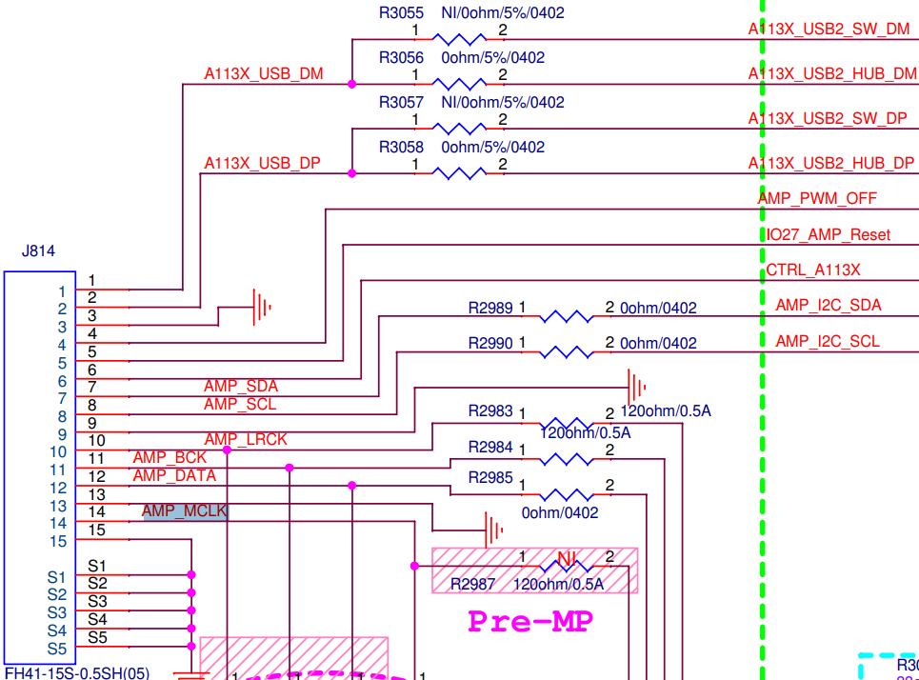
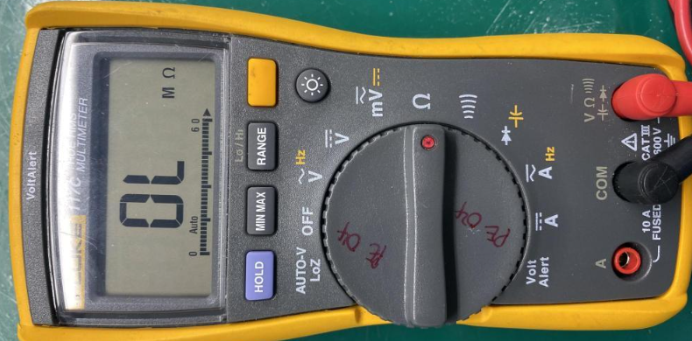
FFC AMP cable checking
1. Measure FFC AMP cable.
-Measure connection of 2 points of FFC AMP cable compared with FFC AMP cable OK
➔ Result as table below.
FFC AMP cable measurement
Pin Name | Value( Ω)-OK sample | Value( Ω)- Sample 1 | Result
1- A113X_USB_DM | 0.2 Ω | ∞ | F
2- A113X_USB_DP | 0.2 Ω | ∞ | F
3- GND | 0.2 Ω | ∞ | F
4-AMP_PWM_OFF | 0.2 Ω | ∞ | F
5-AMP_Reset | 0.2 Ω | ∞ | F
6- CTRL_A113X | 0.2 Ω | ∞ | F
7- AMP_I2C_SDA | 0.2 Ω | ∞ | F
8-AMP_I2C_SCL | 0.2 Ω | ∞ | F
9-GND | 0.2 Ω | ∞ | F
10-AMP_LRCK | 0.2 Ω | ∞ | F
11-AMP_BCK | 0.2 Ω | ∞ | F
12-AMP_DATA | 0.2 Ω | ∞ | F
13-GND | 0.2 Ω | ∞ | F
14-AMP_MCLK | 0.2 Ω | ∞ | F
15-GND | 0.2 Ω | ∞ | F
NG
1
1
A point
B point
Measure connection of 2 points of FFC AMP cable
Summary:
- FFC AMP cable 2 points not connection➔ FFC AMP cable NG.

Slide 5
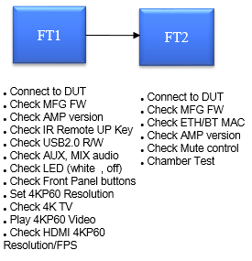
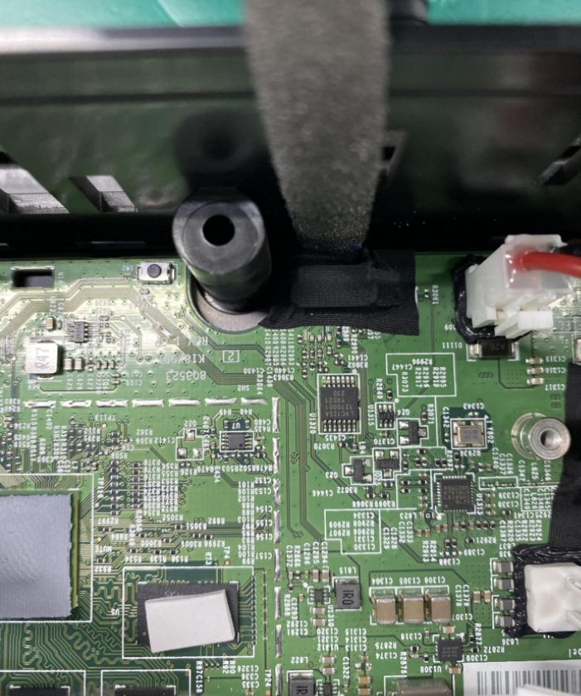
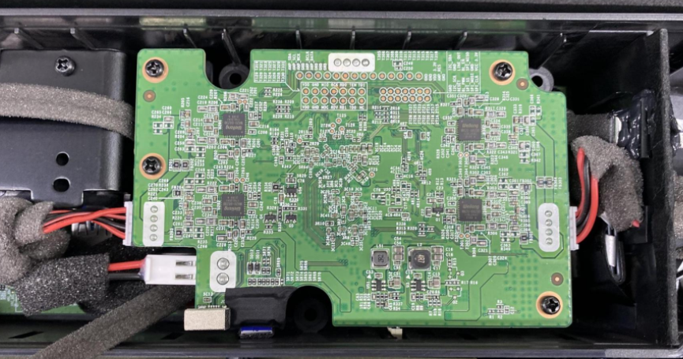
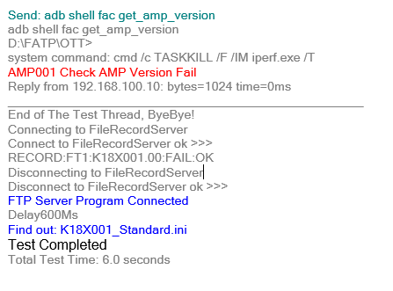
FFC AMP Cable Coverage
1. At test station on line
- FFC AMP cable is connection between K18X001T00 main board and 96.1531T00_AMP board, use FFC AMP cable NG assemble into OK product to test AMP version at FT1, FT2 stations,
FFC AMP cable
Result
FFC AMP cable
Assemble to verify FFC AMP cable
Log test fail at FT1 station
2. Test AMP version by hand
- Re test 3 times AMP version by hand, using command “adb shell fac get_version “ ➔ check AMP version always fail( boot up of AMP board fail )
No # | 1 | 2 | 3
Sample 1 | Fail | Fail | Fail
Remark | Check AMP board version fail
Summary:
- NG FFC AMP cable can cover 100% on FATP

Slide 6
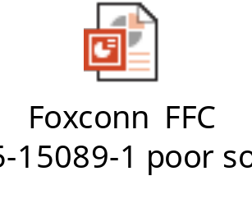
Conclusion
As analysis FFC AMP cable 2 points not connection
NG FFC AMP cable can cover 100% at FT1 station( check version AMP), FT2 station( check version AMP and sound function)..
Send material and report to SQE:Mr. Sy. Done: 2022/06/01.
SQE send FFC AMP cable_376.00039.005 component to P-TWO vendor for further analysis. Due date: 2022/06/03. Owner: SQE Mr. Sy.
2022/06/03 – P-TWO vendor feedback FA report. Pls check on next sheet.

Slide 7
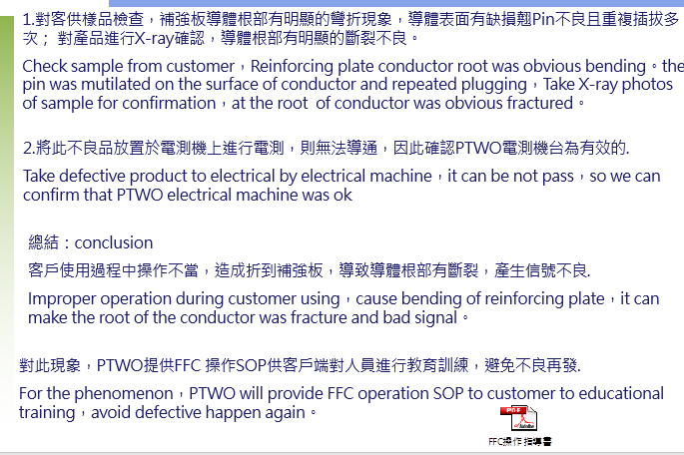
Conclusion

